Slide 1
Capstone Project - 4
Netﬂix Movies and TV Shows Clustering
Team Members:-
1 - Md Kamran
2 - Reena Verma
3 - Mithin Barde
4 - Krunal Sonare
5 - Rishabh Gupta
Alma Better

Slide 2


Contents:
Introduction.
Exploratory Data Analysis.
Dataset Preview.
Hypothesis testing.
Feature selection.
Machine learning algorithms(unsupervised).
K-mean.
agglomerative clustering.
Model performance.
Conclusion.

Slide 3

Introduction:
Netﬂix is a media distribution company. It started with DVD distribution via mail, but has evolved substantially over the course of its existence. Today, Netﬂix is focused on streaming video. Some of its content is licensed, and some of the content is produced in-house.
Netﬂix originally focused on movies, but today television shows are probably the more common format. Netﬂix works on a subscription model, where users get unlimited access to content with a paid subscription.

Slide 4
Dataset Preview:
This dataset consists of tv shows and movies available on Netﬂix as of 2019. The dataset is collected from Flixable which is a third-party Netﬂix search engine.
Attribute Information
date_added : Date it was added on Netﬂix
release_year : Actual Release Year of the movie / show
rating : TV Rating of the movie / show
duration : Total Duration - in minutes or number of seasons
listed_in : Genre
description: The Summary description
show_id : Unique ID for every Movie / Tv Show
type : Identiﬁer - A Movie or TV Show
title : Title of the Movie / Tv Show
director : Director of the Movie
cast : Actors involved in the movie / show
country : Country where the movie / show was produced

Slide 5
Dataset summary:
The dataset contains 12 columns and 7787 rows.
There also exist some null values in oura data: Percentage of null values in director : 30.68%
Percentage of null values in cast : 9.22% Percentage of null values in country : 6.51% Percentage of null values in date_added : 0.13% Percentage of null values in rating : 0.089%
Since there are very few null values in date_added and rating we will drop them.
Finally we will do some feature engineering to create few new variables:
Compute year_added, month_added and day_added from date_added after converting it into datetime variable.

Slide 6
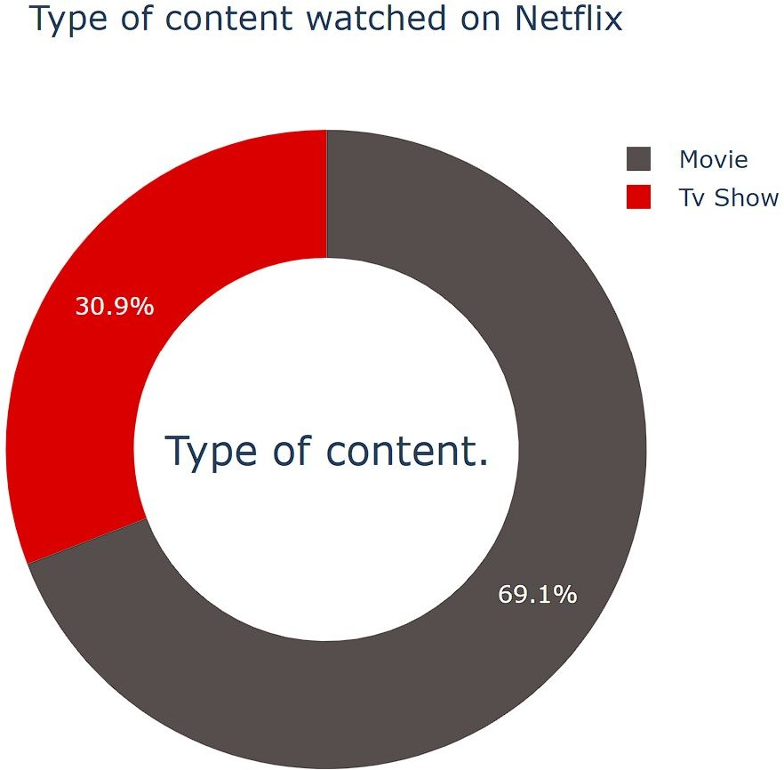
Exploratory Data Analysis:
Type:
69.1% of the content available on Netﬂix are movies; the remaining 30.9% are TV Shows.

Slide 7
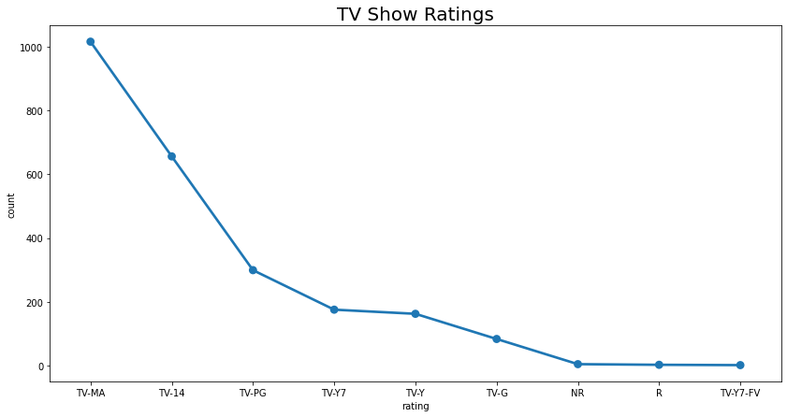
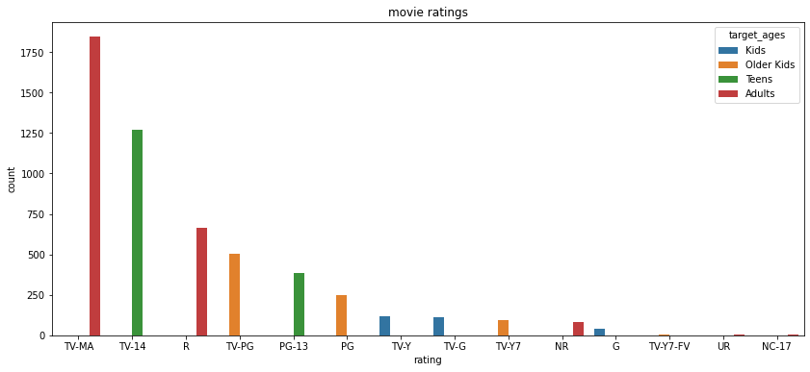
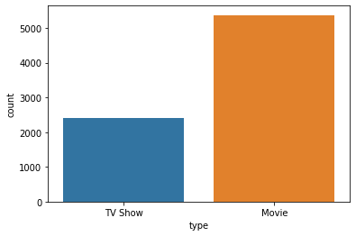
Type
Ratings
TV-MA has the highest number of ratings for tv shows i,e adult ratings
TV-MA has the highest number of ratings for movies i,e adult ratings
in both the cases TV-MA has the highest number of ratings
Netflix has 5372 movies and 2398 TV shows,there are more number movies on Netflix than TV shows.

Slide 8
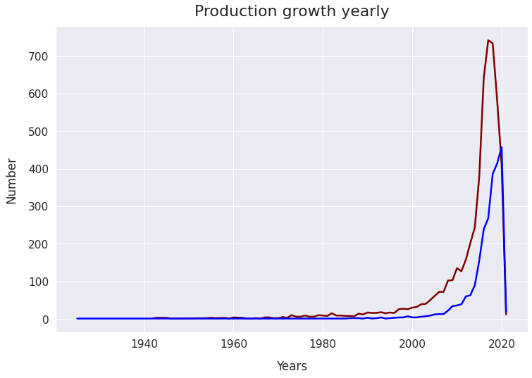
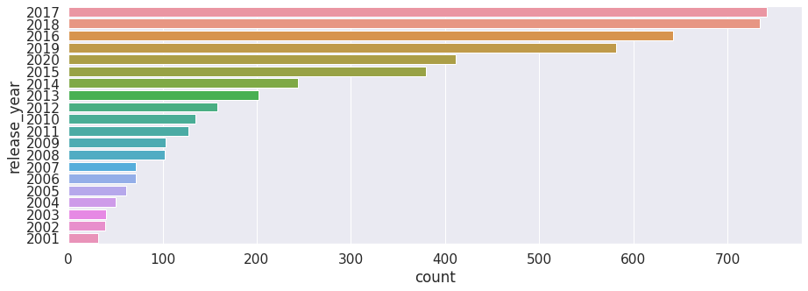
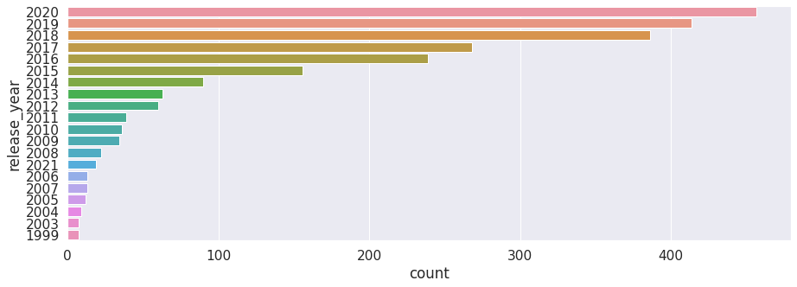
Release year
tv_shows
highest number of movies released in 2017 and 2018
highest number of movies released in 2020
The number of movies on Netflix is growing significantly faster than the number of TV shows.
We saw a huge increase in the number of movies and television episodes after 2015.
there is a significant drop in the number of movies and television episodes produced after 2020.
It appears that Netflix has focused more attention on increasing Movie content that TV Shows. Movies have increased much more dramatically than TV shows.
movies

Slide 9
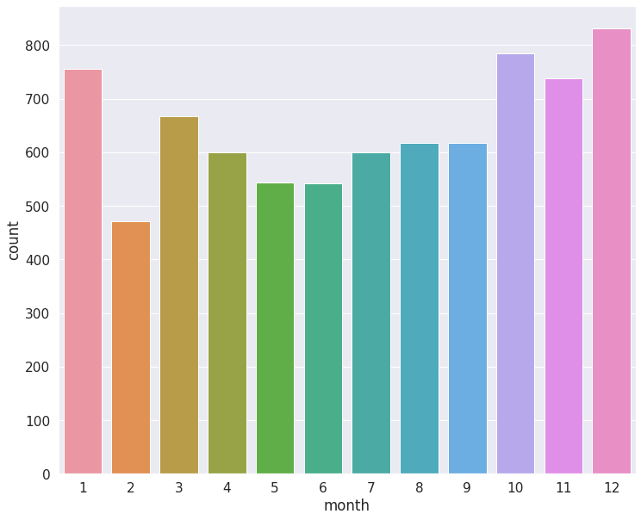
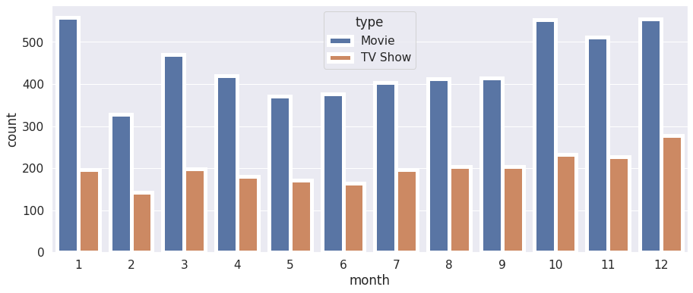
Release month
The above graph shows that in both cases the most content is added to Netflix from october to january

Slide 10
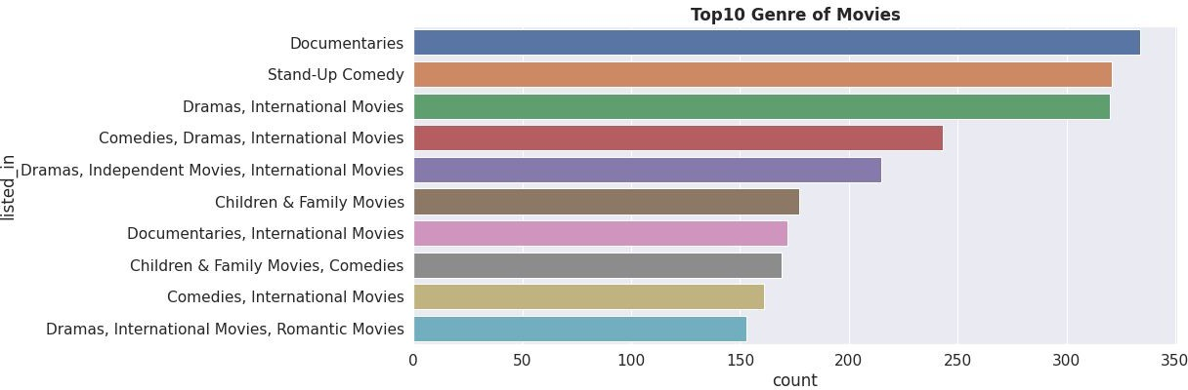
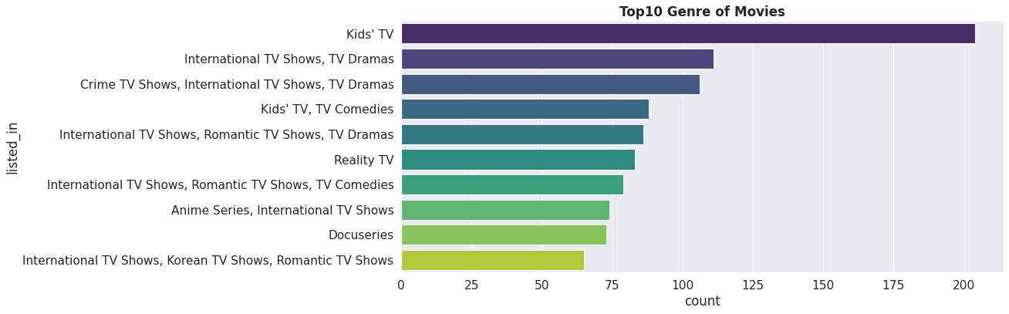
Genre
Documentaries are the top most genre in netflix which is fllowed by standup comedy and Drams and international movies
kids tv is the top most TV show genre in netflix

Slide 11
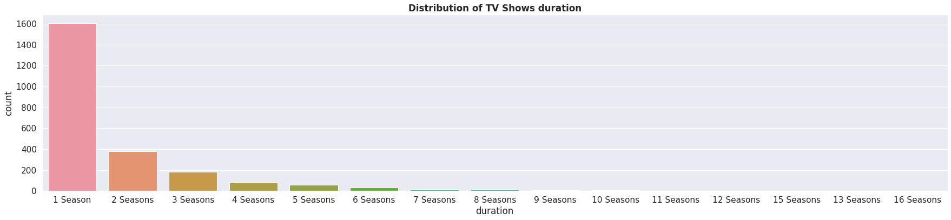
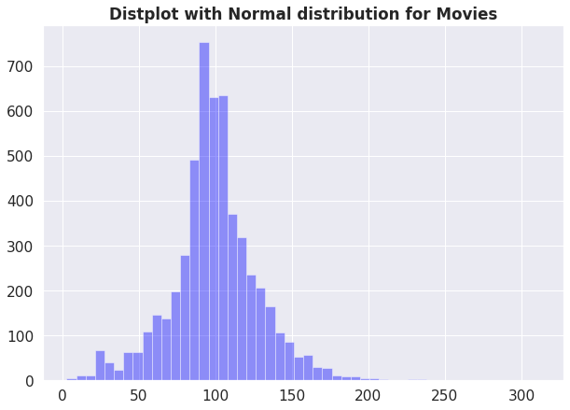
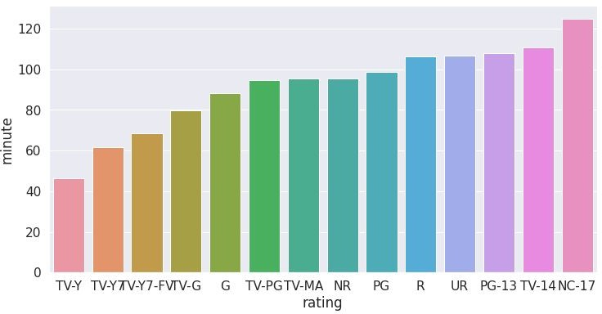
Duration
Highest number of tv_shows consistig of single season
Most of the movies have duration of between 50 to 150
.
Those movies that have a rating of NC-17 have the longest average

Slide 12
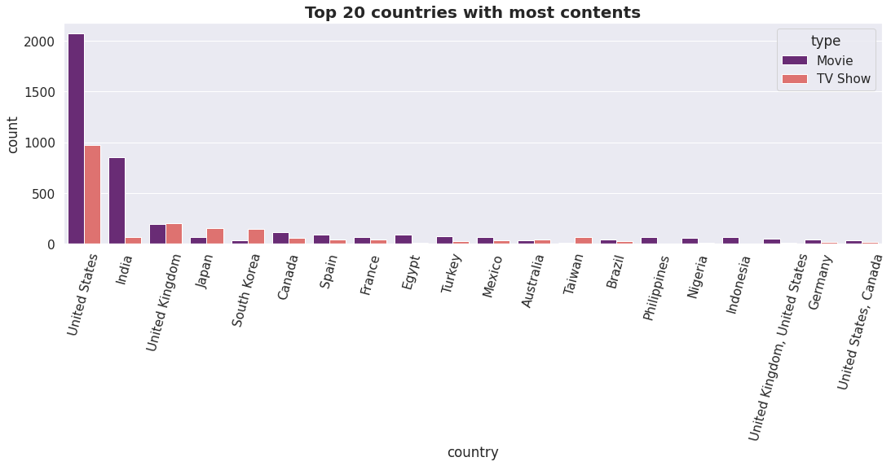
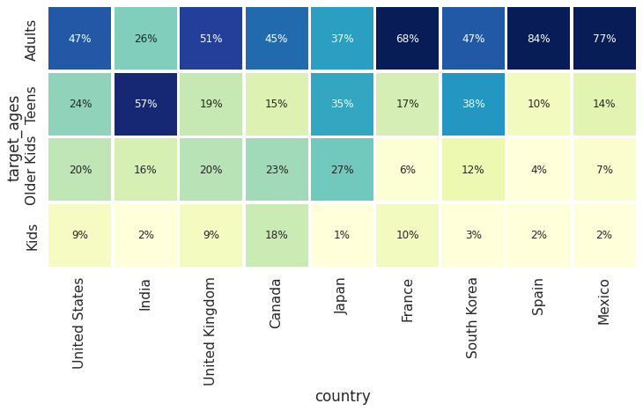
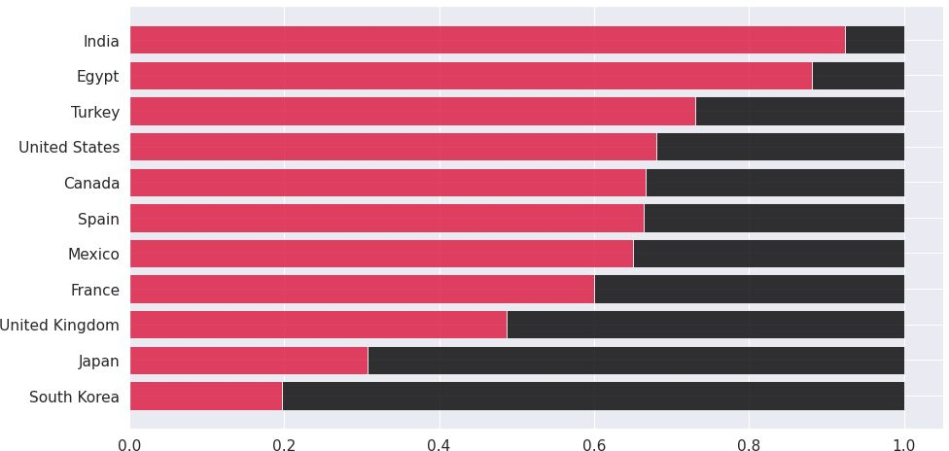
Country
unitated states has the highest number of content on the netflix ,followed by india
india has highest number of movies in netflix
the US and UK are closely aligned with their Netflix target ages, but radically different from, example, India or Japan!
Also, Mexico and Spain have similar content on Netflix for different age groups.

Slide 13
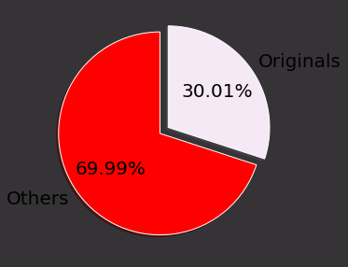
Originals
30% movies released on Netflix.
70% movies added on Netflix were released earlier by different mode.

Slide 14
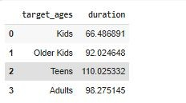
1.HYPOTHESIS TESTING
Hypothesis testing in statistics refers to analyzing an assumption about a population parameter.
HO:movies rated for kids and older kids are at least two hours long H1:movies rated for kids and older kids are not at least two hours long.
the t-value is not in the range, the null hypothesis is rejected.
As a result, movies rated for kids and older kids are not at least two hours long.

Slide 15
2. H1:The duration which is more than 90 mins are movies HO:The duration which is more than 90 mins are NOT movies
.
.
the t-value is not in the range, the null hypothesis is rejected.
As a result, The duration which is more than 90 mins are movies

Slide 16
Features selection
Initially Separating the column type into movie and tv shows
here we are going to do Clustering similar content by matching text-based features so column description is one of the important feature
Convert the text to lower case
Tokenize the text
Removed all the stop words and punctuation
we use TF-IDF is an abbreviation for Term Frequency Inverse Document Frequency. This is very common algorithm to transform text into a meaningful representation of numbers which is used to fit machine algorithm for prediction

Slide 17
ML algorithms(unsupervised
K-mean
agglomerative clustering

Slide 18
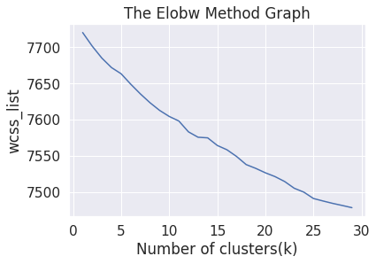
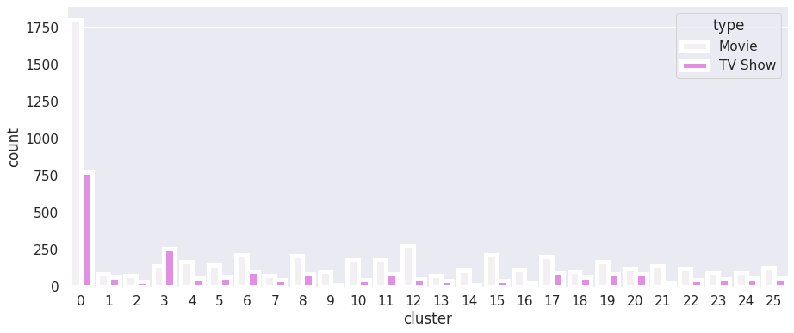
K-Means
K-Means Clustering is an Unsupervised Learning algorithm which groups the unlabeled dataset into different clusters. Here K defines the number of predefined clusters that need to be created in the process, as if K=2, there will be two clusters, and for K=3, there will be three clusters, and so on.
Elbow Method
Result:
Cluster 0 has the hightest number of datapoints and evenly distributed for other cluster
From elbow method generating 26 clusters

Slide 19
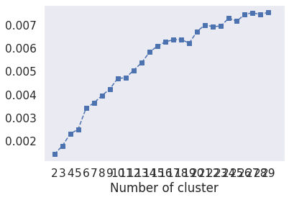
Evaluation
1.Silhouette Score : is a metric to evaluate the performance of clustering algorithm. It uses
compactness of individual clusters(intra cluster distance) and separation amongst clusters (inter
cluster distance) to measure an overall representative score of how well our clustering algorithm
has performed
2.The Davies-Bouldin index (DBI ).It is most commonly used to evaluate the goodness of split
by a K-Means clustering algorithm for a given number of clusters.
Silhouette score would always lie between -1 to 1 representing better clustering.
Silhouette score is 0.007499010681200968
Davies_bouldin_score is 9.05605194948868
So model is performing well

Slide 20
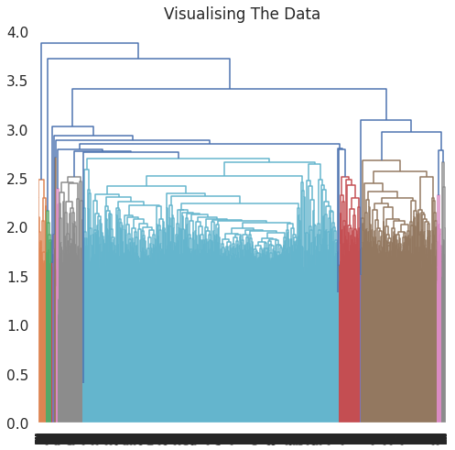
2.Agglomerative Clustering
In agglomerative clustering no need to give the value of k beforehand
The agglomerative hierarchical clustering algorithm is a popular example of HCA
Here I used ward linkage
The optimal number of clusters is 4 using the Dendrogram
Evaluation
Silhouette Coefficient: -0.002
Davies_bouldin_score is 9.05605
Comparing with K mean only Davies_bouldin_score is better for hierarchical clustering Model is not performing well

Slide 21
Conclusion
From elbow and silhouette score, optimal of 26 clusters formed, K Means is better for identification than Hierarchical as the evaluation metrics also indicate the same. In kmean cluster 0 has the highest number of data points and is evenly distributed for another cluster
Netflix has 5372 movies and 2398 TV shows, there are more movies on Netflix than TV shows.
TV-MA has the highest number of ratings for tv shows i,e adult ratings
highest number of movies released in 2017 and 2018 highest number of TV Shows released in 2020 The number of movies on Netflix is growing significantly faster than the number of TV shows. We saw a huge increase in the number of movies and television episodes after 2015. there is a significant drop in the number of movies and television episodes produced after 2020. It appears that Netflix has focused more attention on increasing Movie content than TV Shows. Movies have increased much more dramatically than TV shows.
The most content is added to Netflix from October to January.

Slide 22
Documentaries are the top most genre on Netflix which is followed by standup comedy, Drama, and international movies.
Kids tv is the top TV show genre on Netflix
Most of the movies have a duration of between 50 to 150
Highest number of tv_shows consisting of a single season.
Those movies that have a rating of NC-17 have the longest average duration.
When it comes to movies having a TV-Y rating, they have the shortest runtime on average
United States has the highest number of content on Netflix, followed by India
India has the highest number of movies on Netflix.
30% of movies are released on Netflix. 70% of movies added on Netflix were released earlier in a different mode.

Slide 23

Md Kamran
E-mail: md.codekamran98@gmail.com
Github link: https://github.com/md-kamran98

